Slide 1
Lesson 2 When is Competitive Advantage Sustainable?
Module 2 Competitive Advantage
Date of Presentation

Slide 2
M. Krishna Erramilli
Name of Person

Slide 3
Learning Objectives
Students will be able to describe the concept of sustainable competitive advantage and its importance.

Slide 4
This Lesson
Module 1: What is Competitive Strategy
Lesson 1: What is Competitive Strategy
Lesson 2: Macro-Environmental Analysis
Lesson 3: Industry Analysis
Module 2: Competitive Advantage
Lesson 1: What is Competitive Advantage?
Lesson 2: Sustainable Competitive Advantage
Lesson 3: Value Chain Analysis
Module 3: Choosing a Competitive Strategy
Lesson 3: Best-Cost Strategy
Lesson 1: Cost Leadership Strategy
Lesson 2: Differentiation Strategy

Slide 5
What is Sustainable Competitive Advantage?
Competitive Advantage that is durable and long-lasting is called Sustainable Competitive Advantage
Companies that continue generating superior Economic Value Created (EVC) on a long-run basis enjoy a Sustainable Competitive Advantage

Slide 6
Every Company is a Unique Bundle of Resources
Assets
Skills
Capabilities
Competencies
Business Processes
Knowhow
Firm
Assets
Capabilities
Competencies
Processes
Knowhow
Skills

Slide 7
Types of Resources
Tangible Resources
Real estate
Plant and equipment
Intangible Resources
Intellectual Property (Patents, Trademarks, Copyrights, Trade Secrets)
Leadership and Technical Skills
Organizational Culture

Slide 8
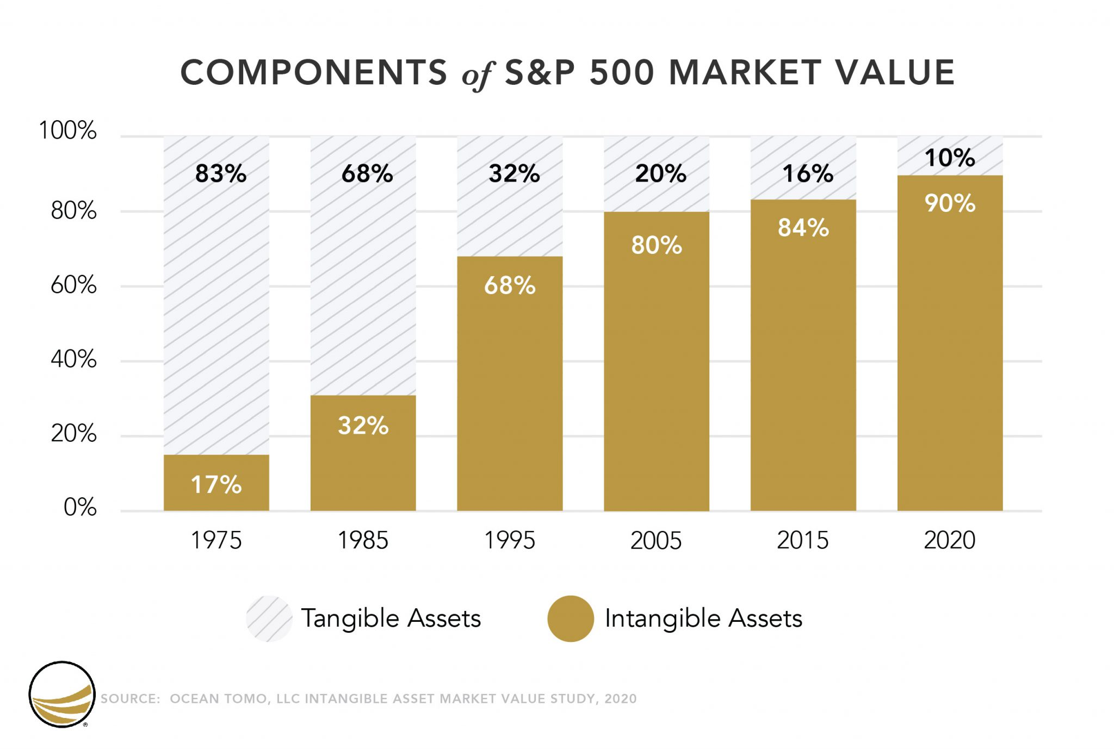
Intangible Resources Are The Primary Driver of Market Value

Slide 9
What are Strategic Resources?
Resources that possess ALL of the following characteristics (VRIO):
(1) Valuable
(2) Rare
(3) Difficult To Imitate
(4) Organized To Capture Value

Slide 10
Strategic Resources & Sustainable Competitive Advantage
"Only Strategic Resources Give a Company Sustainable Competitive Advantage"

Slide 11

Analyze Gadget Galore's Resources
Production plant
Advanced Machinery
Skilled talent (hired on a contract basis)
Strong culture for innovation

Slide 12
Does Production Plant Give SCA?
Valuable? | Rare? | Costly to Imitate | Organized to Capture Value | Competitive Implications
No |  |  |  | Competitive Disadvantage
Yes | No |  |  | Competitive Parity
Yes | Yes | No |  | Temporary CA
Yes | Yes | Yes | No | Temporary CA
Yes | Yes | Yes | Yes | Sustainable CA

Slide 13
Does Avanced Machinery Give SCA?
Valuable? | Rare? | Costly to Imitate | Organized to Capture Value | Competitive Implications
No |  |  |  | Competitive Disadvantage
Yes | No |  |  | Competitive Parity
Yes | Yes | No |  | Temporary CA
Yes | Yes | Yes | No | Temporary CA
Yes | Yes | Yes | Yes | Sustainable CA

Slide 14
Does Skilled Talent Give SCA?
Valuable? | Rare? | Costly to Imitate | Organized to Capture Value | Competitive Implications
No |  |  |  | Competitive Disadvantage
Yes | No |  |  | Competitive Parity
Yes | Yes | No |  | Temporary CA
Yes | Yes | Yes | No | Temporary CA
Yes | Yes | Yes | Yes | Sustainable CA

Slide 15
Does Organizational Culture Give SCA?
Valuable? | Rare? | Costly to Imitate | Organized to Capture Value | Competitive Implications
No |  |  |  | Competitive Disadvantage
Yes | No |  |  | Competitive Parity
Yes | Yes | No |  | Temporary CA
Yes | Yes | Yes | No | Temporary CA
Yes | Yes | Yes | Yes | Sustainable CA

Slide 16
Conclusion: What is Sustainable Competitive Advantage?
Competitive Advantage that is durable and long-lasting is called Sustainable Competitive Advantage
Companies that continue generating superior Economic Value Created (EVC) on a long-run basis enjoy a Sustainable Competitive Advantage
Sustainable Competitive Advantage results when the company develops a competitive strategy which actively deploys its strategic resources

Slide 17
Next Lesson
Module 1: What is Competitive Strategy
Lesson 1: What is Competitive Strategy
Lesson 2: Macro-Environmental Analysis
Lesson 3: Industry Analysis
Module 2: Competitive Advantage
Lesson 1: What is Competitive Advantage?
Lesson 2: Sustainable Competitive Advantage
Lesson 3: Value Chain Analysis
Module 3: Choosing a Competitive Strategy
Lesson 3: Best-Cost Strategy
Lesson 1: Cost Leadership Strategy
Lesson 2: Differentiation Strategy

